Slide 1


Group Members:
Linda Levy
Raph Serrano
Swobabika Jena
Jason Sutton

Slide 2
Section A: Describe core message and questions of interest (clearly stated hypothesis and defined directionality (more, less, increase):
As investors, our project is to uncover investment opportunities for Airbnb in Melbourne metropolitan area. What type of investment property, and which Melbourne location would give us the best outcome for our investment.

Slide 3
Section A: Describe core message and questions of interest (clearly stated hypothesis and defined directionality (more, less, increase):
Questions of interest – version 1:
relationships between neighbourhoods and occupancy rate,
revenue and occupancy
whether ratings have an impact on profitability
proximity to train stations (as a significant transport option) and occupancy

Slide 4
Section A: Describe core message and questions of interest (clearly stated hypothesis and defined directionality (more, less, increase):
Questions of interest – version 2 (original questions from proposal):
The highest occupancy rates are in which neighbourhoods. The highest earners are in which neighbourhoods Is there a correlation? Are high occupancies the highest earners.
What neighbourhoods have the highest ratings? Is there a correlation with the highest earners? If there is no correlation with overall rating, is there a particulate category that rates highly with high earners.
What is the average distance to a train station in each neighbourhood? If occupancy rates and revenue are the same neighbourhoods, is close proximity to a train station a contributing factor? If occupancy rates and revenue are in different neighbourhoods, which one has a close proximity to a train station a contributing factor?

Slide 5
Section A: Describe core message and questions of interest (clearly stated hypothesis and defined directionality (more, less, increase):
Hypothesis
Neighbourhood and train proximity would have a direct relationship with occupancy.
Neighbourhood would have a direct impact on profitability.
Review numbers will be important when considering occupancy

Slide 6
Section B: Summarise where and how the data was found:
Airbnb data from Kaggle
Concerns about the datasets had us bring down data from ‘Inside Airbnb’
Partially available in csv format
Larger aspects of the data available in .gz format (Gnu zipped), which required unzipping (in Winzip) to save as a .csv
Train station information from Victorian Department of Environment, Land, Water and Planning DELWP. Spatial data, ordered and then downloaded as .csv file

Slide 7

C. Data Wrangling
Data from inside Airbnb was:
extremely large in numbers of the datasets
Not clearly defined
Multiple columns referred to location property - neighbourhood - neighbourhood cleansed – city - smart-location
Only one of these matched the coordinates stored against the Airbnb listing
Quite messy
eg room type was free form - we had 1 ”castle” in Melbourne on the listing
Typos in information
multiple spellings and configuration of suburb names)

Slide 8
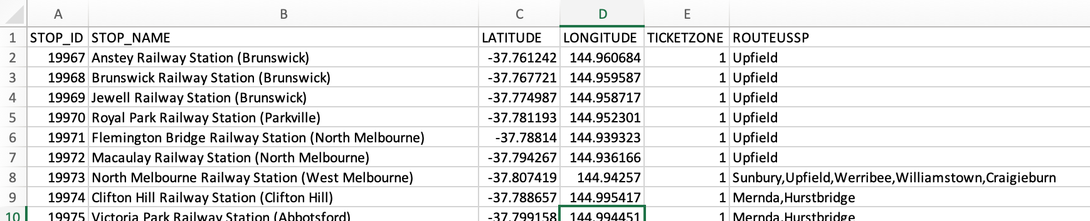

C. Data Wrangling
Data from DELWP was:
containing train stop name, stop id, longitude and latitude
Quite large
this was be reduced once scope for the data from insideairbnb is finalised
Clean, succinct, ready to be mined

Slide 9
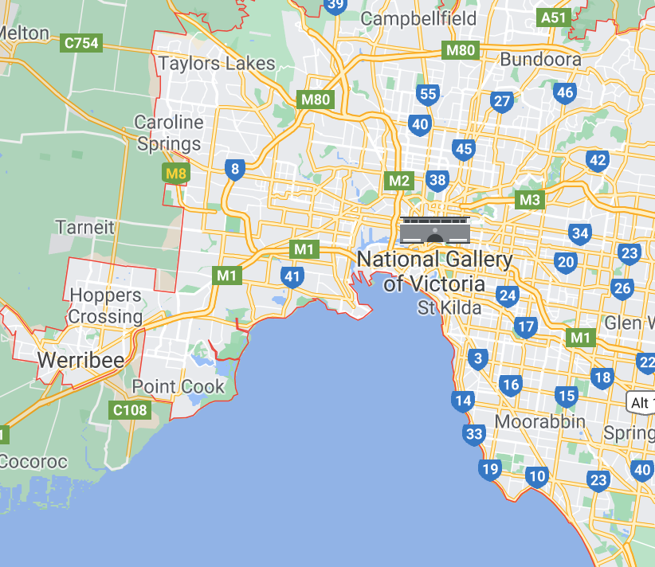

C. Data Wrangling
First Wave - Irrelevant records
CSV file read into Jupyter Notebook
Based on the data needs for our questions, the following records were not required and dropped from the data frame.
Room type:
The question is around investing in an Airbnb property so we are only interested in entire homes
Dropped private rooms / shared rooms / hotel rooms
Drop irrelevant columns
Neighbourhood:
To focus on purely metropolitan properties we dropped listings to within 15km of CBD
Achieved by using latitude and longitude in data to determine the distance from the CBD
Used loc property for Room type and Neighbourhood

Slide 10
C. Data Wrangling
Second Wave - Data clean of rubbish fields
Followed the Ultimate guide to data cleaning - towardsdatascience.com
Checked for duplicates
none identified
Check data info for null field
using df.info()
Replace null value with relevant data
Fill string values with "missing” or relevant value
Filled integer values with 0
Check the relevant columns dtypes
All columns presented as objects (strings)
converted relevant columns to integers and floats
including stripping currency of its formatting

Slide 11

C. Data Wrangling
Second Wave - Data clean of rubbish fields
strip leading and trailing space
checked unique values in city column
corrected spelling mistakes
formalized suburb naming conventions
dropped non-sensical data
Drop further irrelevant columns as awareness of data grew.
Lesson learned
Once the null values had been populated, each cleaning step was a discrete task – not dependant on the previous step.
The work could have been divided among the group.

Slide 12
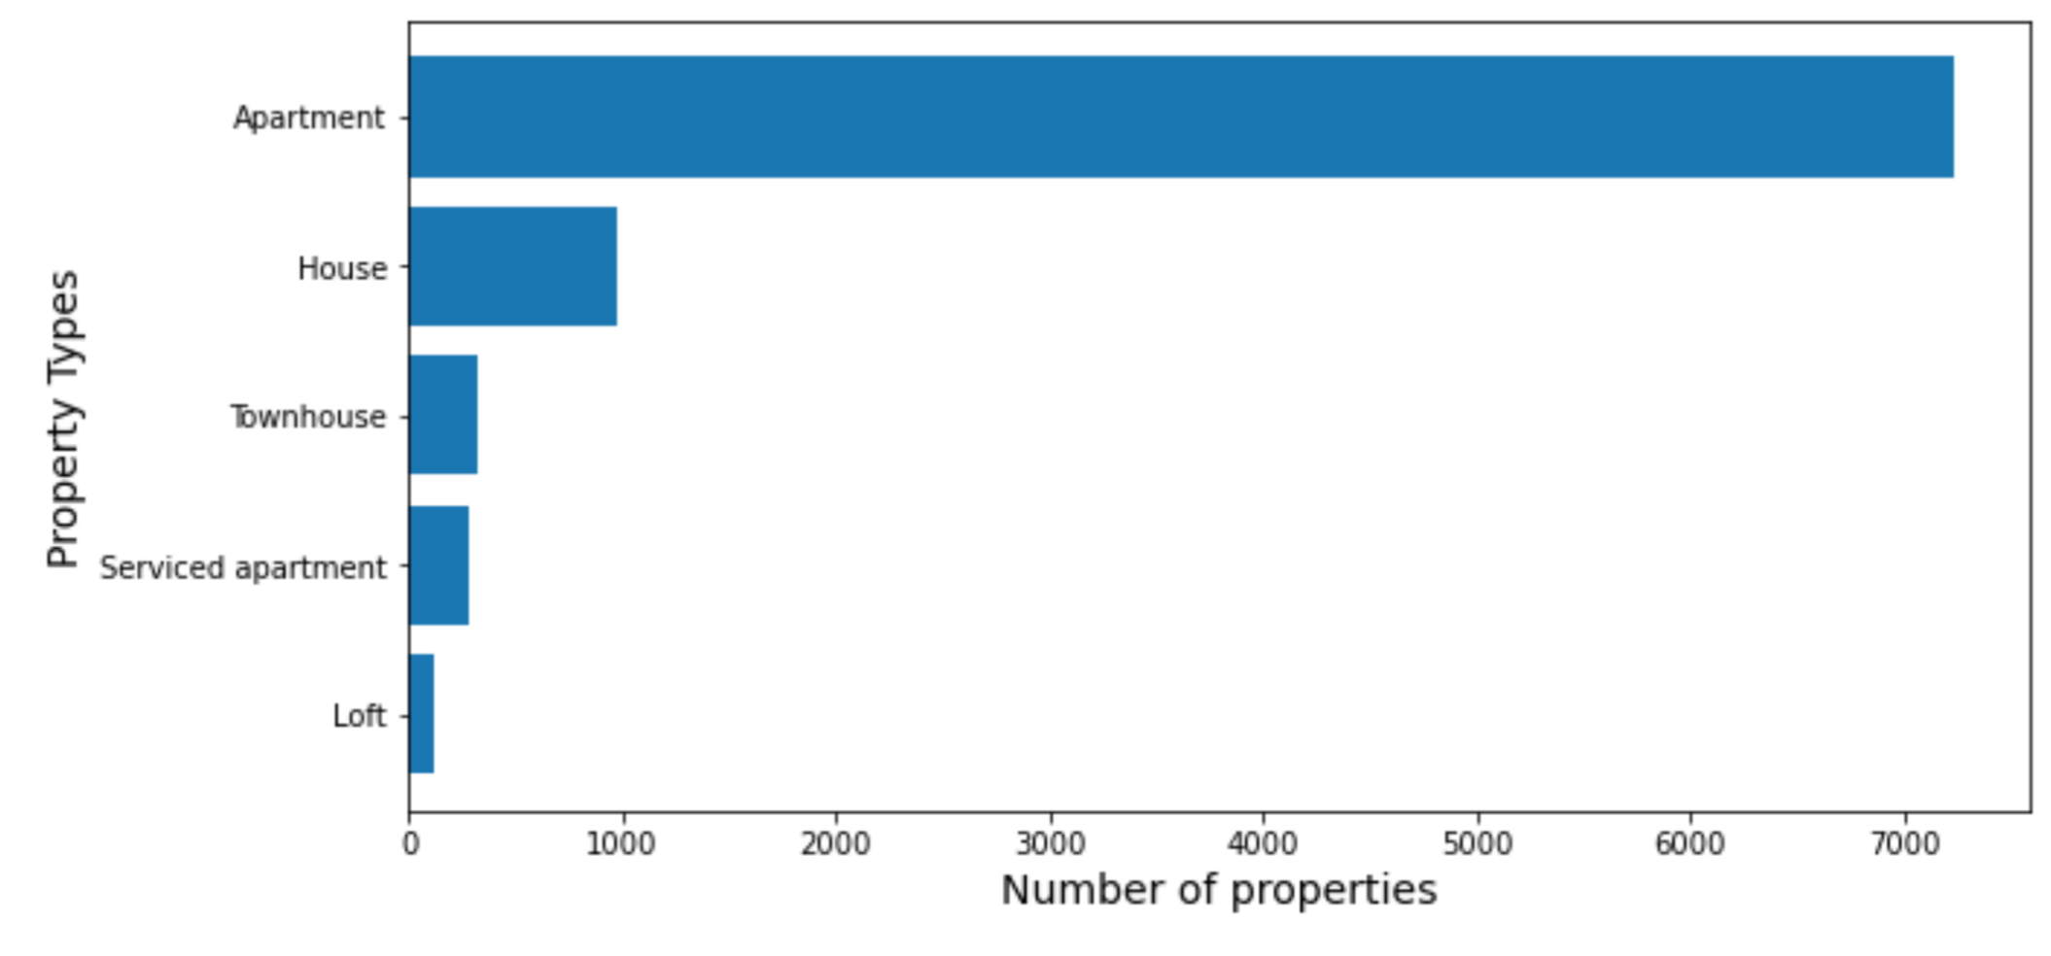
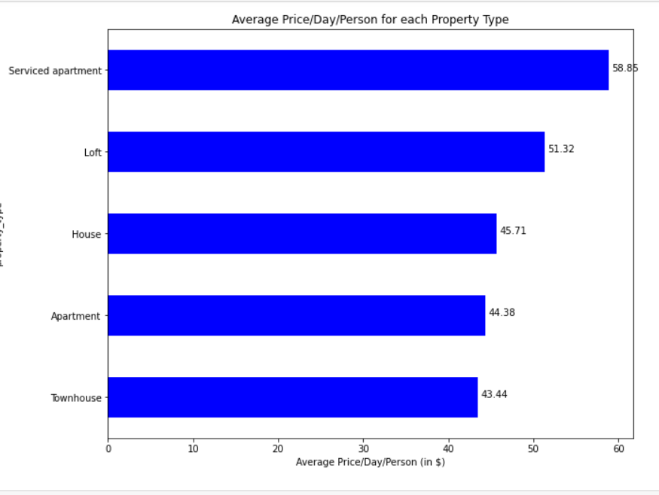

C. Data Wrangling
Third Wave - Decision to only analyse apartments
Apartments were the vast majority of property types.
Three other property types were showing higher rates per person
It felt unwise to be basing decisions on anyting other than apartments

Slide 13
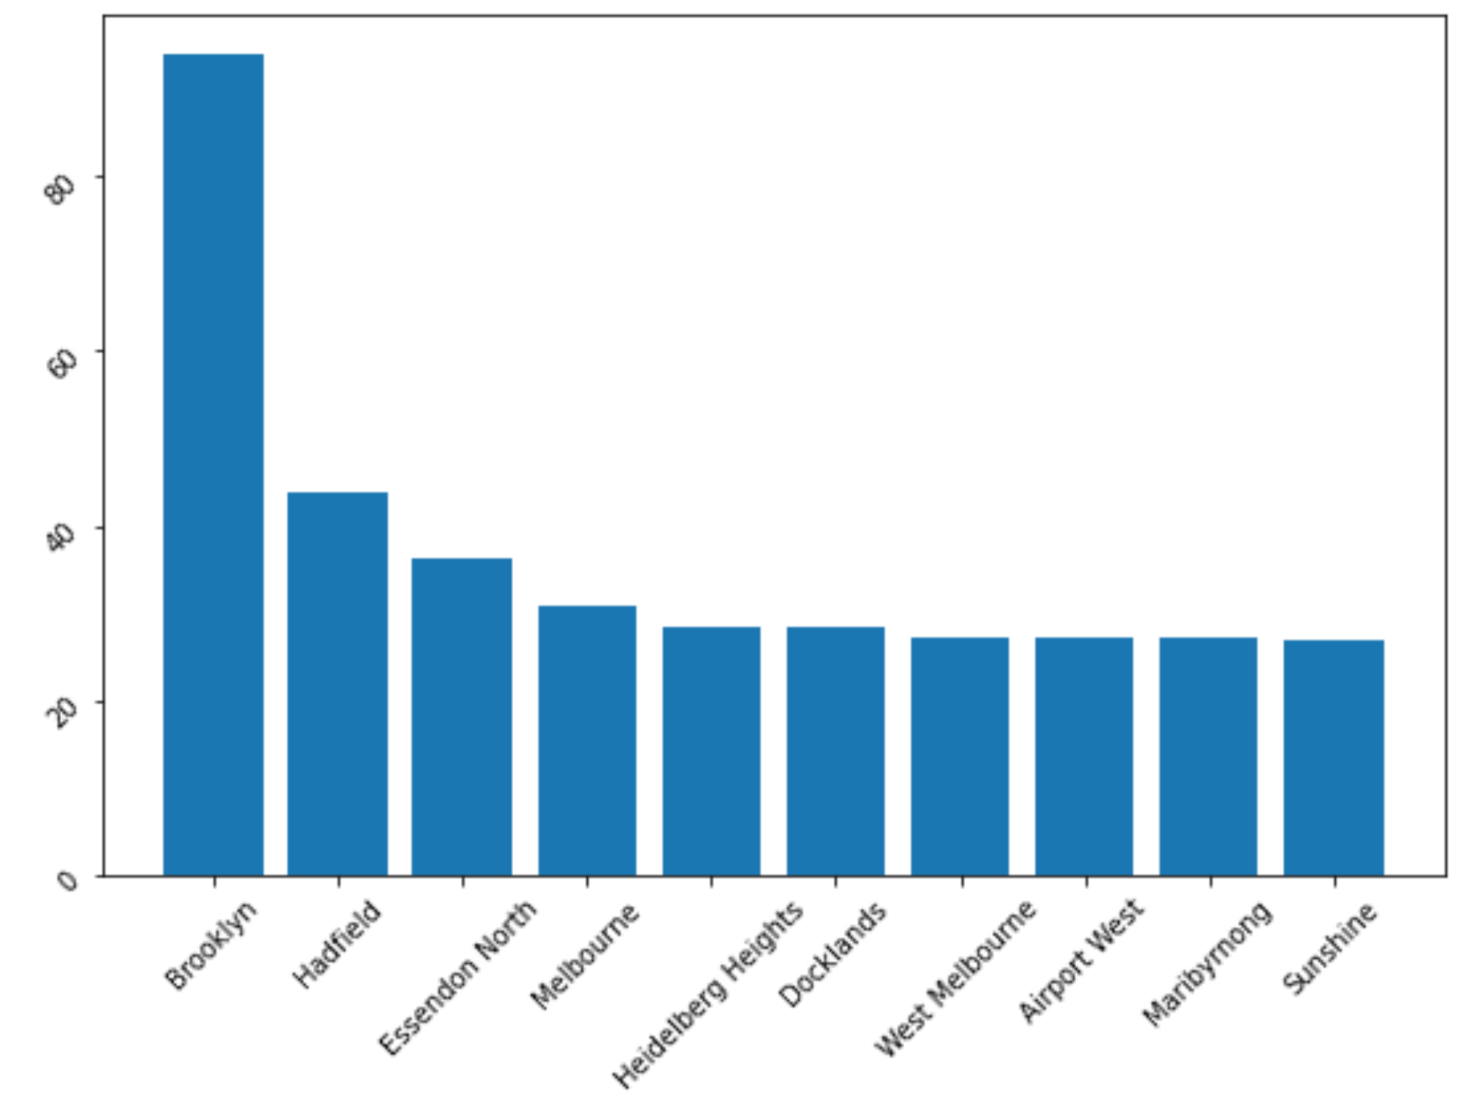


C. Data Wrangling
Fourth Wave - small data misleading outcomes
We met to compare our findings and a number of results didn’t ring true
Areas of high value were based on very small data sets.
Was Brooklyn really getting the most reviews per month?

Slide 14
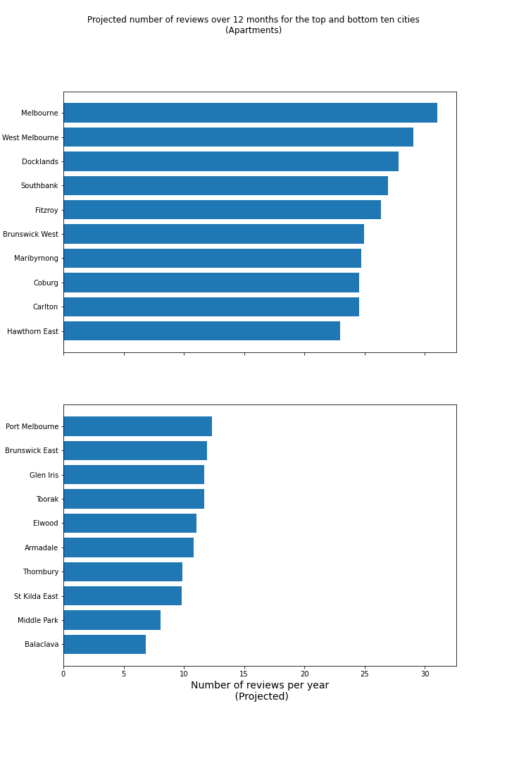

C. Data Wrangling
Fourth Wave - small data misleading outcomes
We made a decision to remove any suburbs with low data points as it meant the data was too small to be meaningful
The resulting data passed the common sense test.
At each wave a new CSV was exported

Slide 15
Indication of occupancy – All property types
As an indication to occupancy rates, we looked at the number of ratings per month for each listing in our data. We wanted to include the popularity of areas within Melbourne to our decision making as investors.
LImitations
We were unable source actual data for occupancy rates. Other data considered was availability of the listing but as a host can limit the availability of the listing, we felt that was even more problematic that the number of reviews posted.

Slide 16
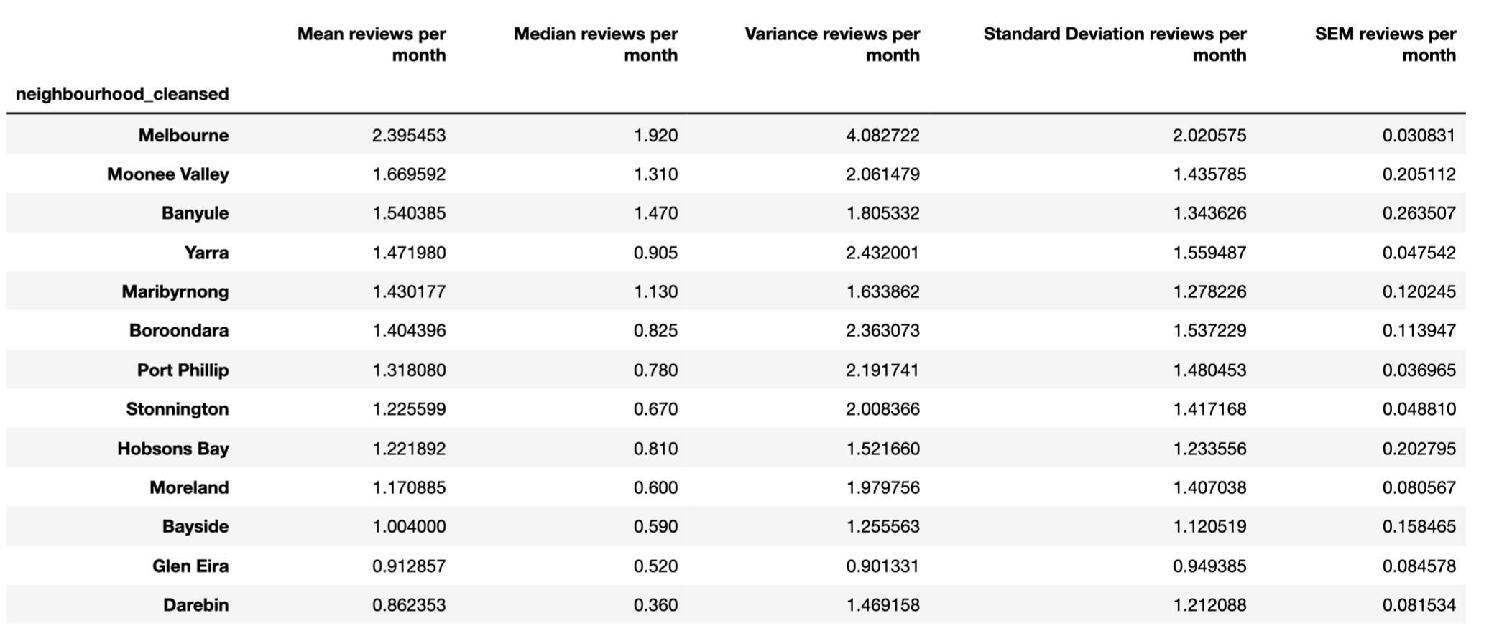
Neighbourhood - Summary Table
Indication of occupancy – All property types
Looking at the Mean and variance, the median is possibly the best measure of central tendency.
Not surprisingly, Melbourne stands out with the highest median reviews per month.
With the variances indicating a wide range of "occupancies" throughout each neighbourhood, it was beneficial to break the data down and see if there was more consistency at the individual suburbs level

Slide 17
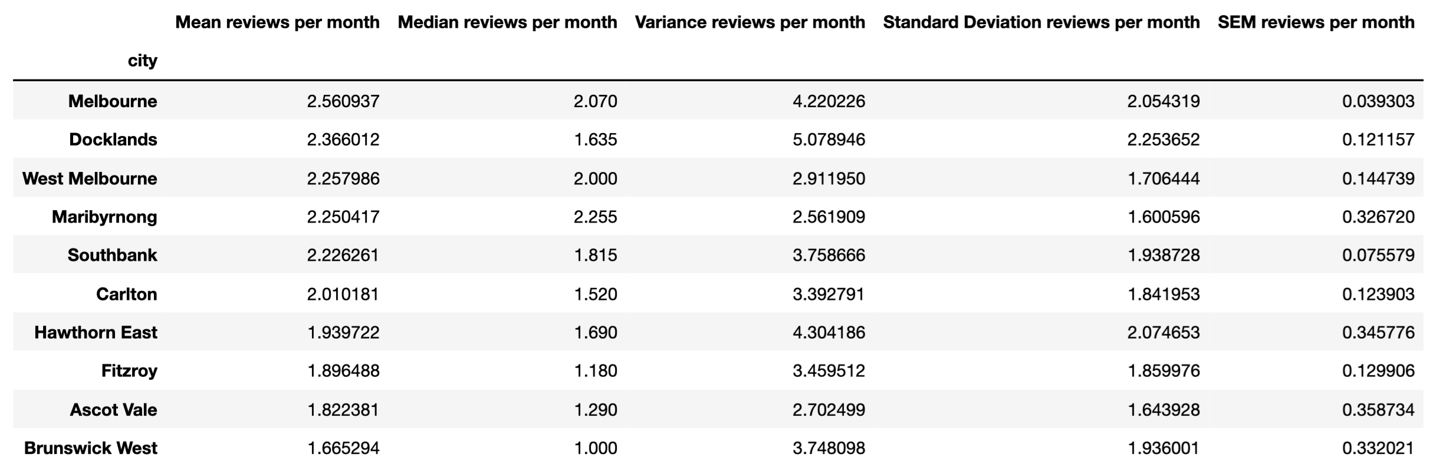
Indication of occupancy – All property types
Top Ten Suburbs - Summary Table
?

Slide 18
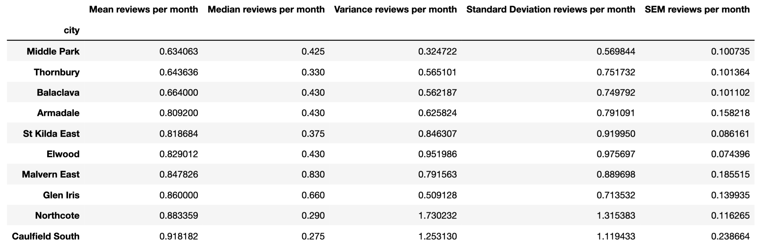
Indication of occupancy – All property types
Bottom Ten Suburbs - Summary Table
Breaking it down into suburbs has allowed us to better see areas of interest and areas to avoid.
Of note, some of the bottom ten suburbs are in areas I would have considered popular tourist areas - ie
Balaclava
St Kilda East
Elwood
This further calls into question the viability of using number of reviews as an indication of occupancy rates.

Slide 19
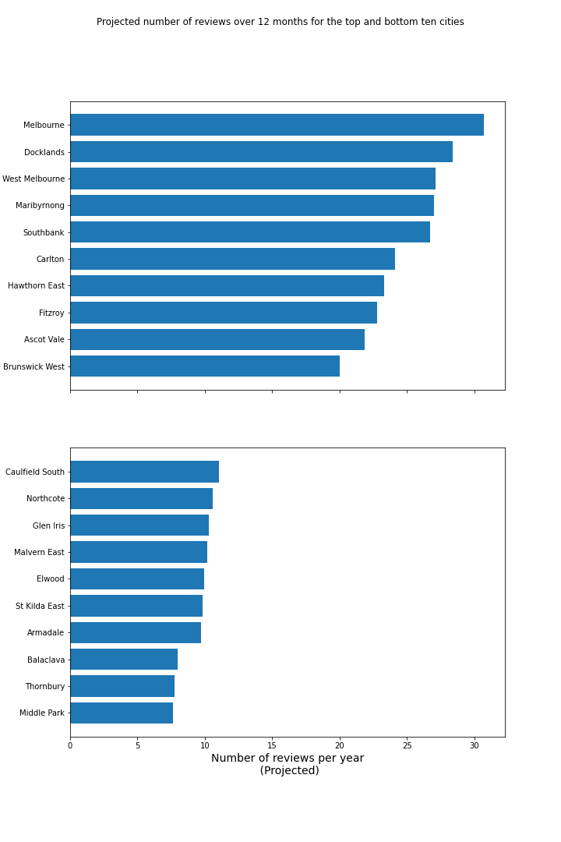
Indication of occupancy – All property types
Top Ten and Bottom Ten Suburbs – Bar Plot
To get a sense of how reviews per month might look for a year, the data has be extrapolated to over 12 months

Slide 20
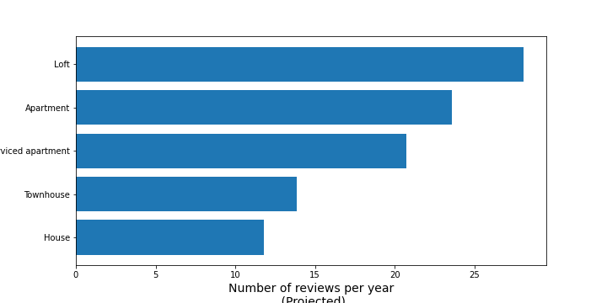
Indication of occupancy – All property types
Occupancy by property type
Although lofts were the property type with the highest number of reviews it was based on the smallest number of data points.
The second highest in the chart is apartment. As this is by far the highest amount of property types in the data, and with the highest indication of "occupancy", we decided to only look at apartments.

Slide 21
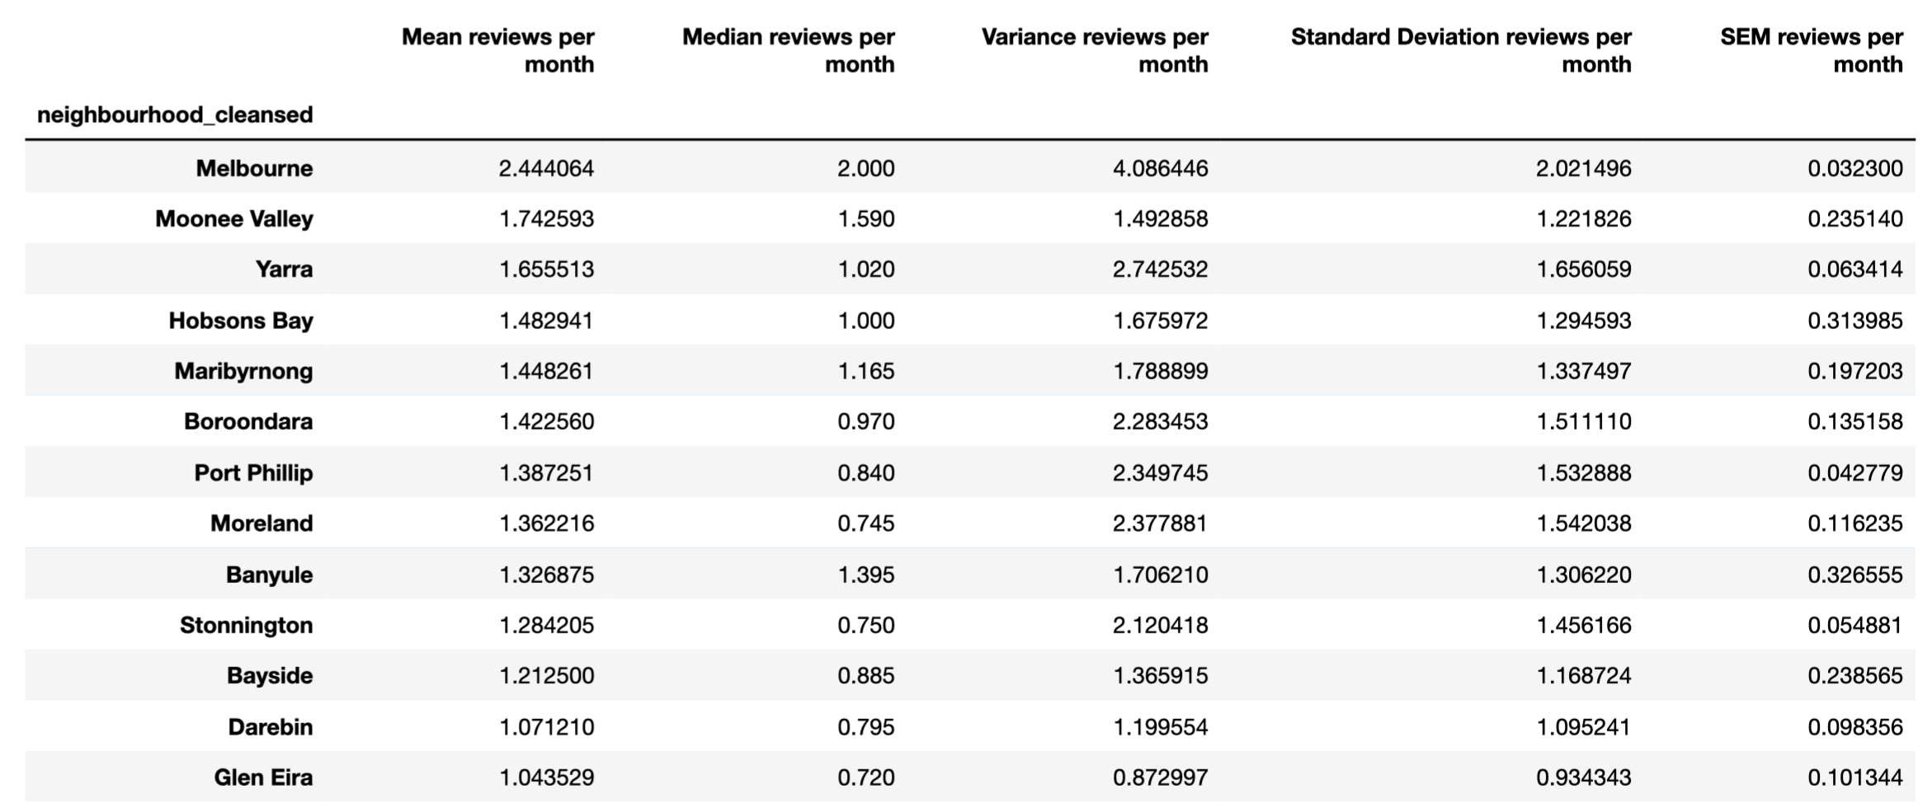
Neighbourhood - Summary Table
Indication of occupancy – Apartments
No further major insights into neighbourhood summary

Slide 22
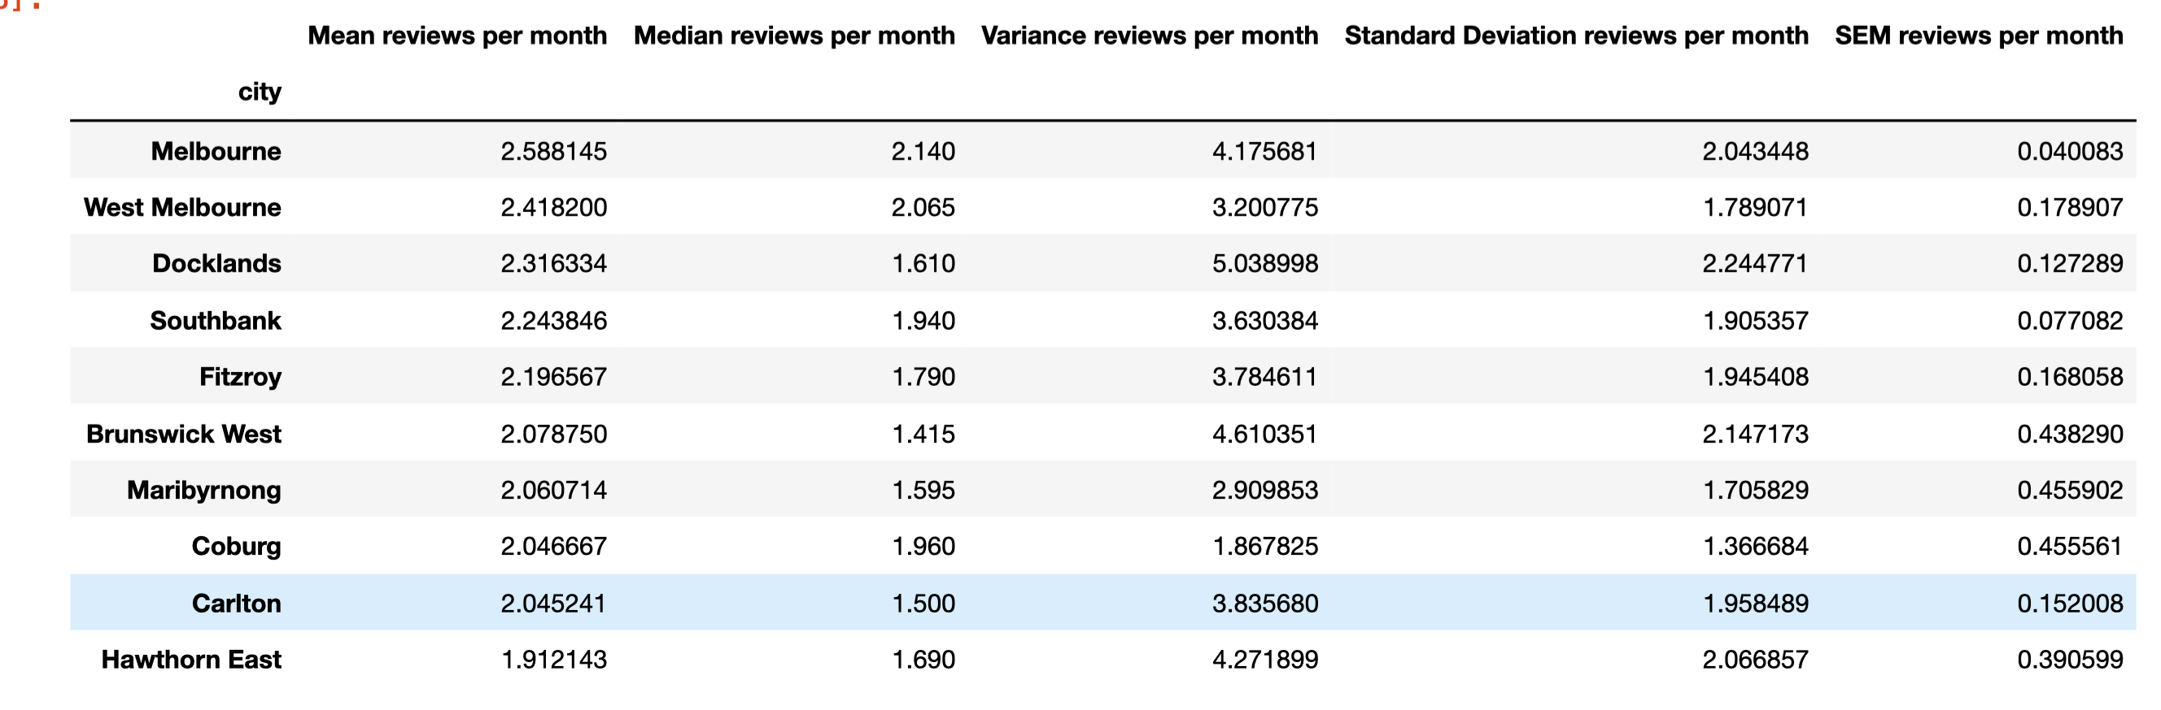
Indication of occupancy – Apartments
Top Ten Suburbs - Summary Table
?

Slide 23
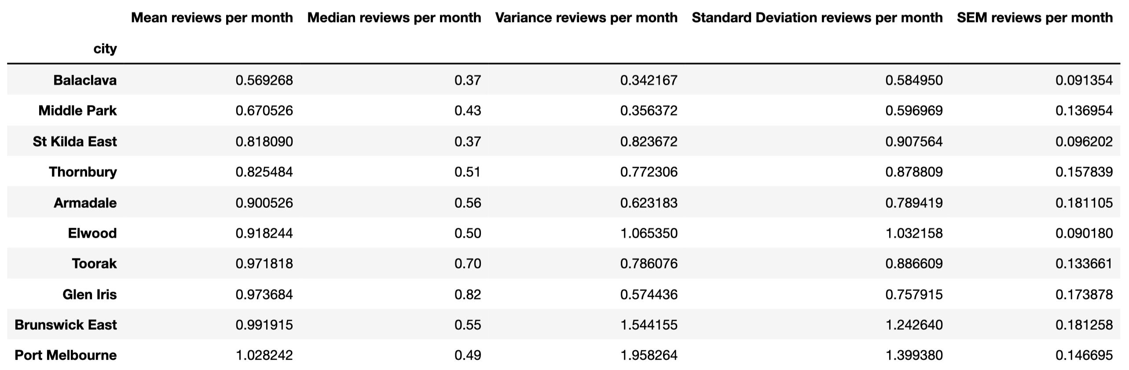
Indication of occupancy – Apartments
Bottom Ten Suburbs - Summary Table
?

Slide 24
Indication of occupancy – Apartments
Top Ten and Bottom Ten Suburbs – Bar Plot
?

